Slide 1
Tech workers experience precarious employment, unpredictable working hours, sedentary, and often socially isolating working conditions. Research on psychosocial working conditions suggests that these factors are likely to have significant impacts on workers' mental and physical health. Increasingly, research is suggseting that workplace cultures that encourage workers to disclose their mental health issues to colleagues and supervisors may improve the likelihood that workers will disclose mental health conditions, leading to better long-term outcomes for tech workers.
The aims of this project are therefore to explore the factors that impact on tech workers mental health over two observation periods, before the COVID-19 pandemic (2014) compared with during the COVID-19 pandemic (2020-2022).
Executive summary:
Overview
Project goals
How does this relate to the industry we selected

Slide 2
Datasource:
Describe the data source
Why we chose it
Describe the collection, exploration and cleanup process.
Approach we took to achieve our goals

Slide 3
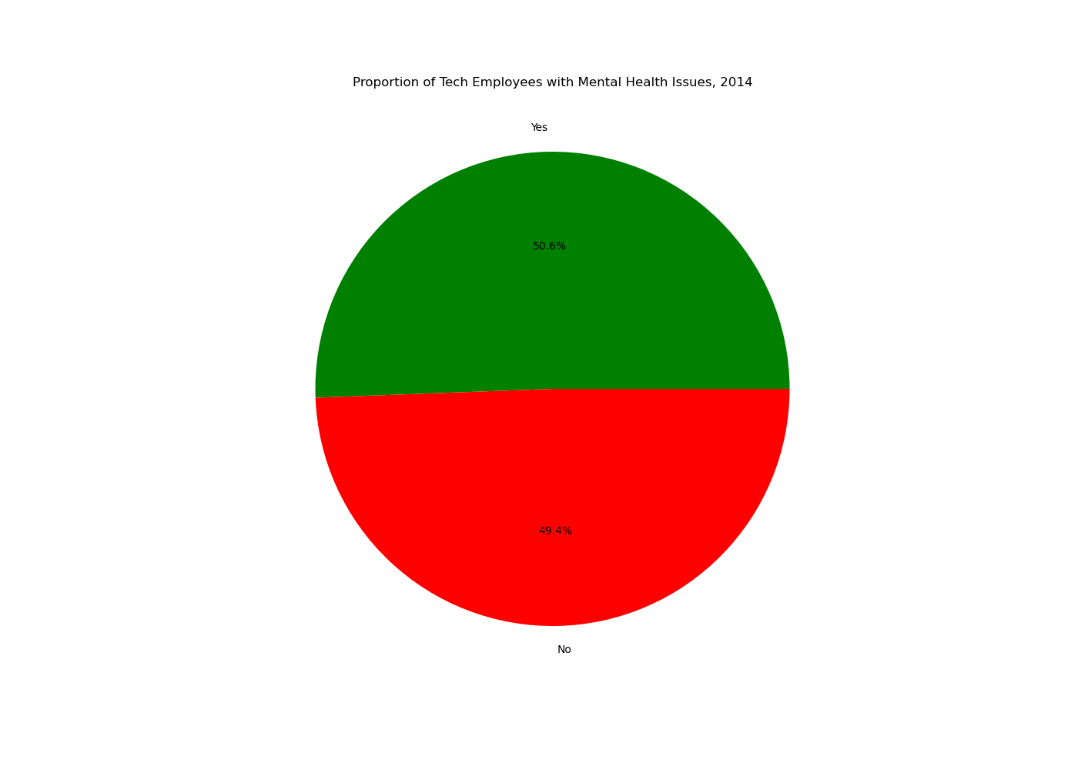


Slide 4
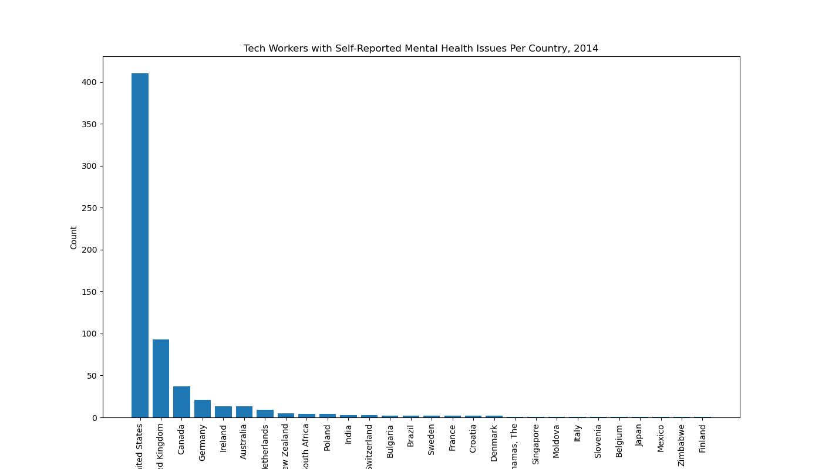
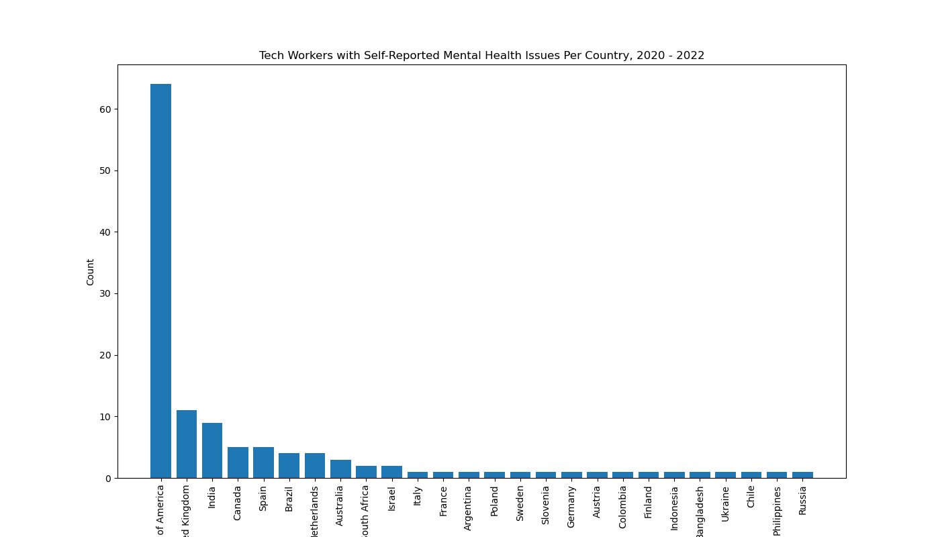
Limitations: majority of participants from US

Slide 5
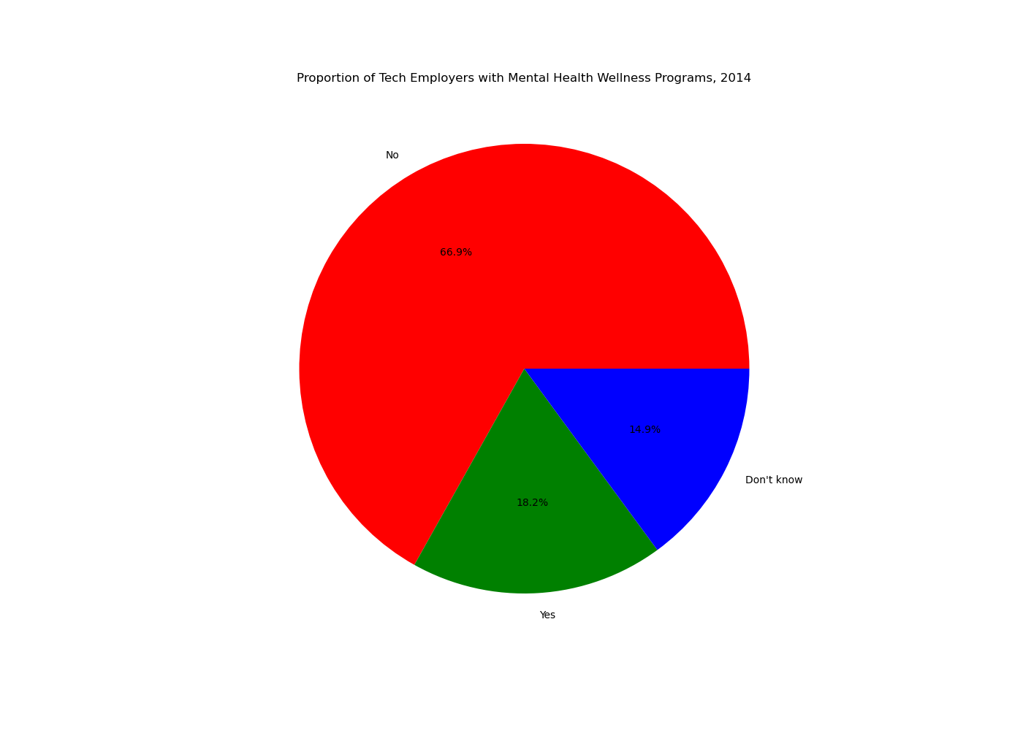
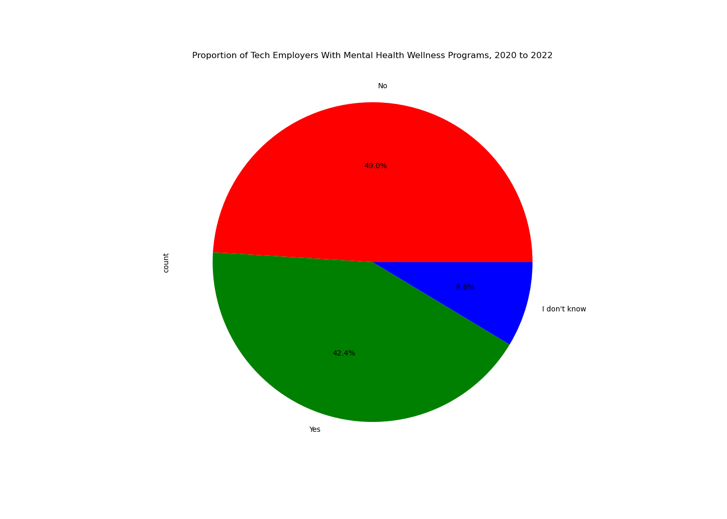
Significant increase in tech companies that provide mental health wellness programs, a positive result from the pandemic and or a better recognition or understanding of mental health issues. Change %numbers, larger titles etc

Slide 6
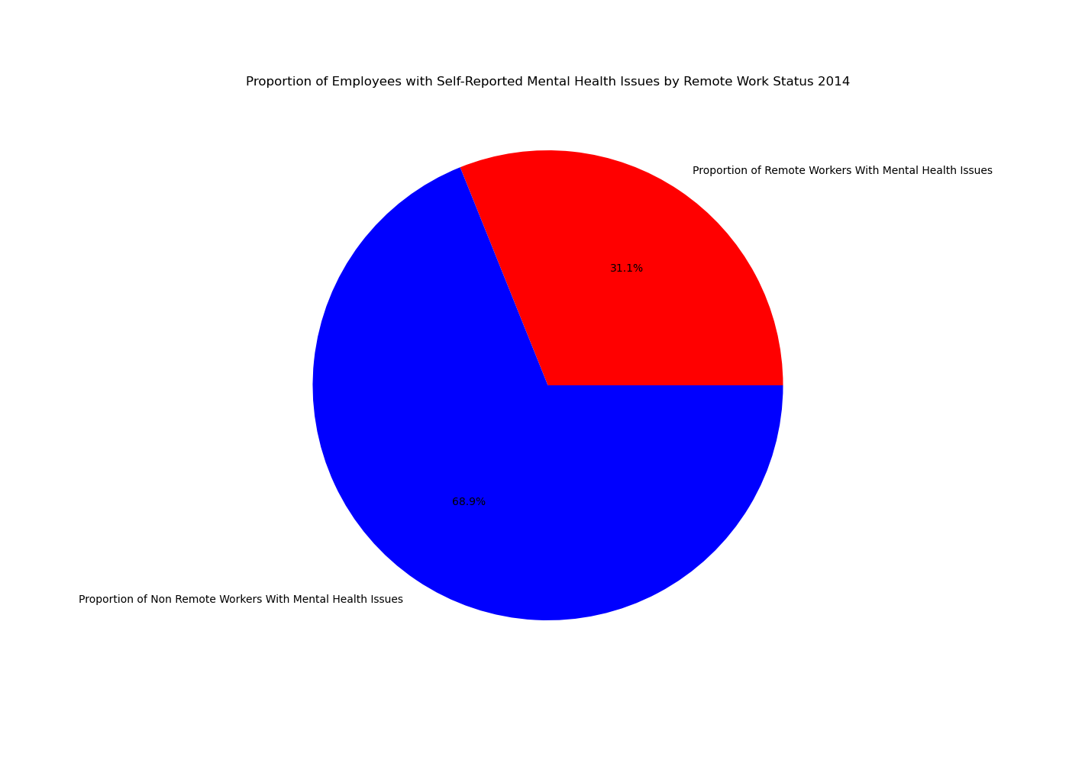
Mental health issues more prevalent in office-based workers pre-covid, this result is unexpected.

Slide 7
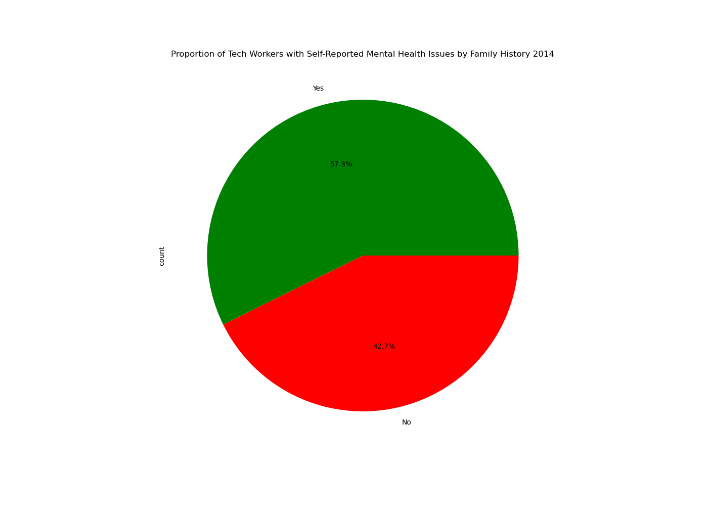
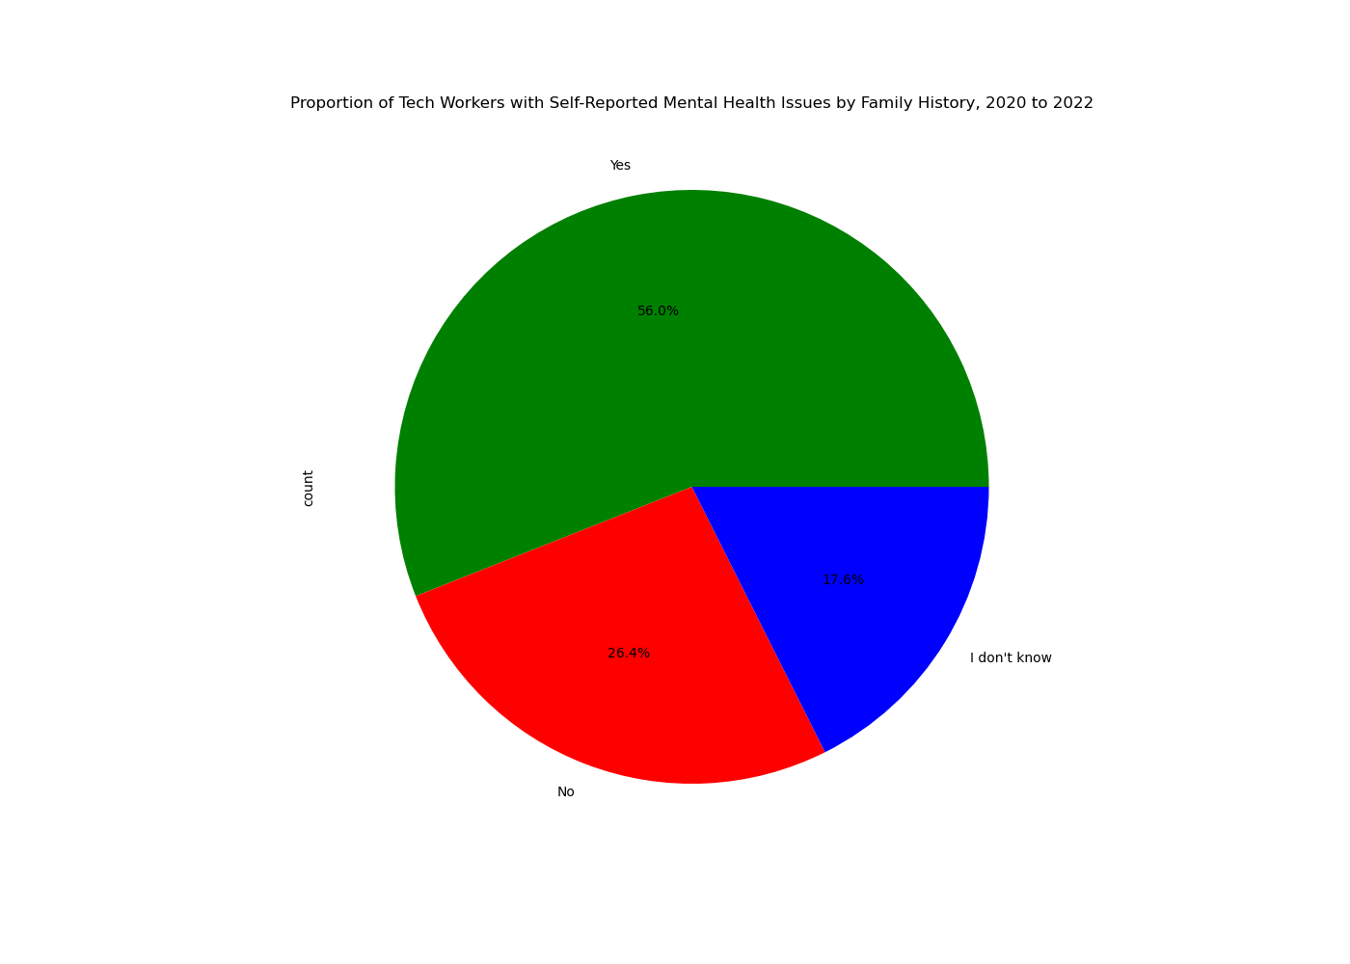
Results show that the pandemic didn’t really impact the percentage of tech workers with mental health issues where there was a family history of mental health issues. Also unexpected.

Slide 8
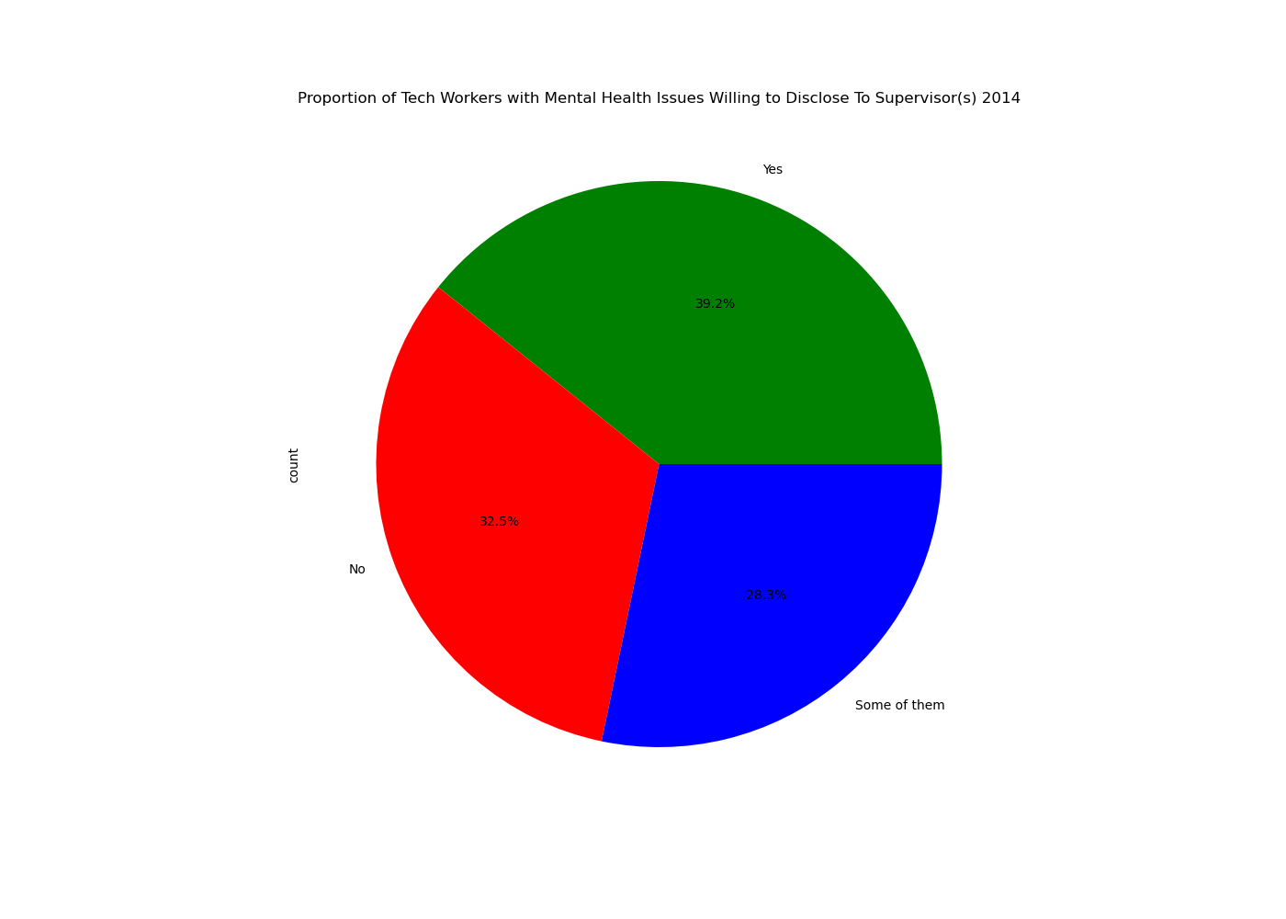

No change, despite the counts in the dataframes being completely different. (we didn’t just replicate the same graph ;). How to show value counts in pie chart – Siyuan or Chris

Slide 9
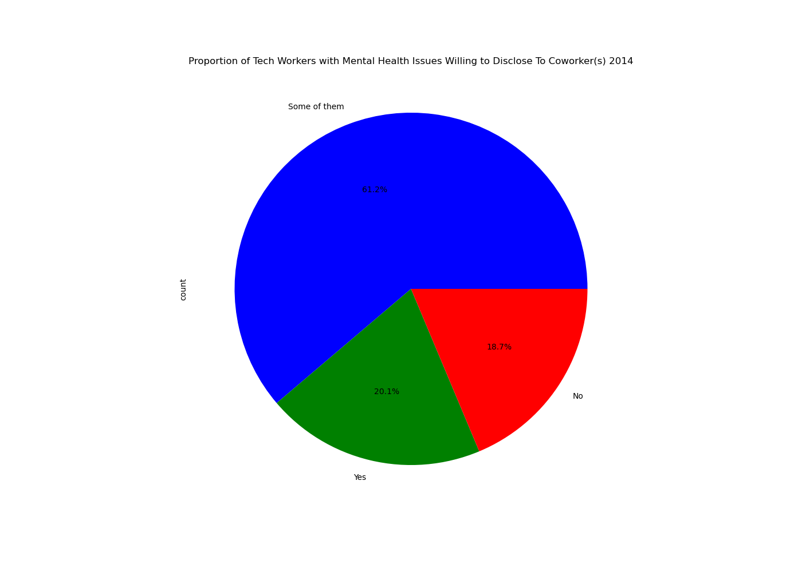
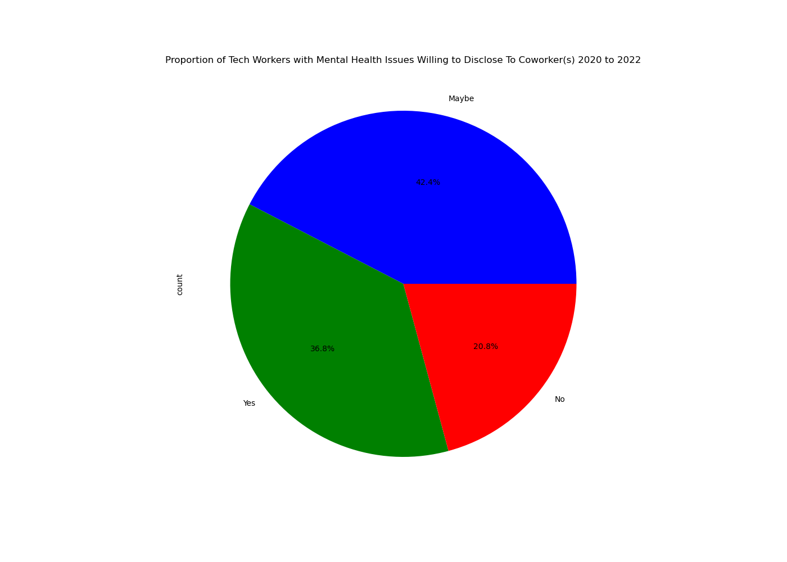
Increase in percentage of employees willing to talk to co-workers, however from previous slide, no change in willingness to disclose to supervisors.

Slide 10
Conclusions:
Despite greater uptake of employer wellness programs post covid, employees saw no change in confidence to disclose to their supervisor.
Briefly discuss potential next steps for the project.
Placeholder
Add in overall prevalence of mental health issues for both datasets.

